Slide 1


SAP Full-Stack Developer training
ABAP on HANA, UI5 & Fiori, Analytics with OData
Anubhav Oberoy
Day – 19
Notes:
www.anubhavtrainings.com

Slide 2

Agenda – Day 19
Introduction of Analytic Designer
Difference between Story & Application
Hierarchies Representation
Creating Analytic Designer Application
Understanding SAP Fiori Integration
--Break--
Describing Connection
Types of Connection
Acquired Data Connection
Live Data Connection
Showing How it Works
Create CDS for Analytics
Consume CDS View in Analytics Cloud (SAC)
Notes:
www.anubhavtrainings.com

Slide 3

SAP Analytics Designer
SAP Analytics Cloud, analytics designer enables analytics application designers to create centrally governable analytic content, ranging from dashboards achieved through guided analytics to sophisticated Planning and Smart applications.
SAP Analytics designer Completes the Analytics Cloud. It gives us advance scripting capabilities with which we can design complex applications like SAP Lumira designer.
We can use different controls like Input, Dropdown, Checkbox, Radio Button, and powerful scripting capabilities using Java Script lightweight.
Java Script is a browser’s programming language.
It has nothing to do with Java Programming.
Every browser understand JS Directly.
Notes:
www.anubhavtrainings.com

Slide 4
Story v s Application
Covers Standard Scenario
01
01
Covers Custom Scenario
Non-technical consultants
02
02
Programmers/App Developers
Build Dashboards for BI , Planning etc.
03
03
Design end to end apps which can call SAP Backend systems
Like BOBJ Designer, Crystal
04
04
Complex Applications as per needs
Has features of stories + Extra
Notes:
www.anubhavtrainings.com

Slide 5
Hierarchy Representation
Hierarchical Representation
Flat Representation
Notes:
www.anubhavtrainings.com

Slide 6
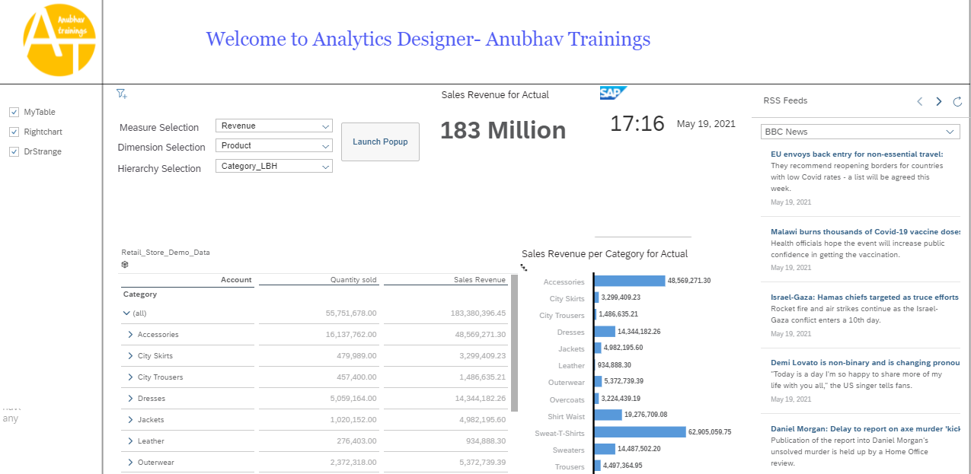
Creating Analytic Designer Application
Exercise :
Analytic Designer App Scenario
Analytic Designer Java Script Code
Notes:
www.anubhavtrainings.com

Slide 7

Break
Notes:
www.anubhavtrainings.com

Slide 8

Connection
Acquired Data
Connection
Connection with Real system but SAC will fetch all the data and load it in itself
All the data will be stored securely in SAC, but the data security is subjected to SAC
Data needs to be updated timely basis using update jobs
New data is available in SAC near Real-time
All the smart features are supported on Acquired data
E.g. Google drive, S/4HANA Connection, BW, BPC, DowJons, …
Live Data Connection
Data is NEVER replicated in SAC but only the skeleton/structure of the data is stored in SAC (metadata)
When the stories are executed, data will be
loaded at runtime from the target system
Data Security, roles, constraints will be the duty of source system. Data is always real-time
We can reuse existing assets like CDS, Bex, InfoProviders, Universe
Little performance lag
Notes:
www.anubhavtrainings.com

Slide 9

How Connection Works
Intranet
Connection
In.A
SAP Analytics Cloud
SCC
Source System On-prem
SAC Analytic Agent
Connection
Adaptor
Source System
On-prem (AWS)
ABAP
SAP HANA
Notes:
www.anubhavtrainings.com

Slide 10
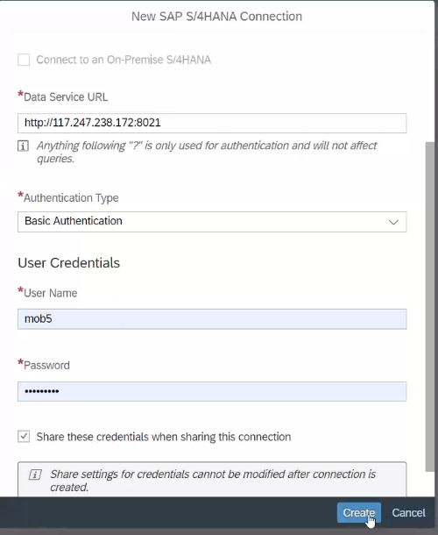
Acquired Data Connection
Service URL get from our S/4HANA System
Assign Basic Authentication
Credentials of our S/4HANA System
Notes:
www.anubhavtrainings.com

Slide 11
Creating CDS View for Analytics
Exercise :
CDS View Code
@AbapCatalog.sqlViewName: 'ZJANSALESSAC'
@AbapCatalog.compiler.compareFilter: true
@AbapCatalog.preserveKey: true
@AccessControl.authorizationCheck: #CHECK
@EndUserText.label: 'sac Consumption view'
@VDM.viewType: #CONSUMPTION
@Analytics.dataCategory: #CUBE
@Analytics.dataExtraction.enabled: true
@OData.publish: true
define view ZJAN_C_SALES_SAC as select from SEPM_I_SalesOrderItem_E
{
//SEPM_I_SalesOrderItem_E
---CODE----
}
VDM Annotation
Analytic Control Annotation
OData exposure Annotation
Notes:
www.anubhavtrainings.com

Slide 12
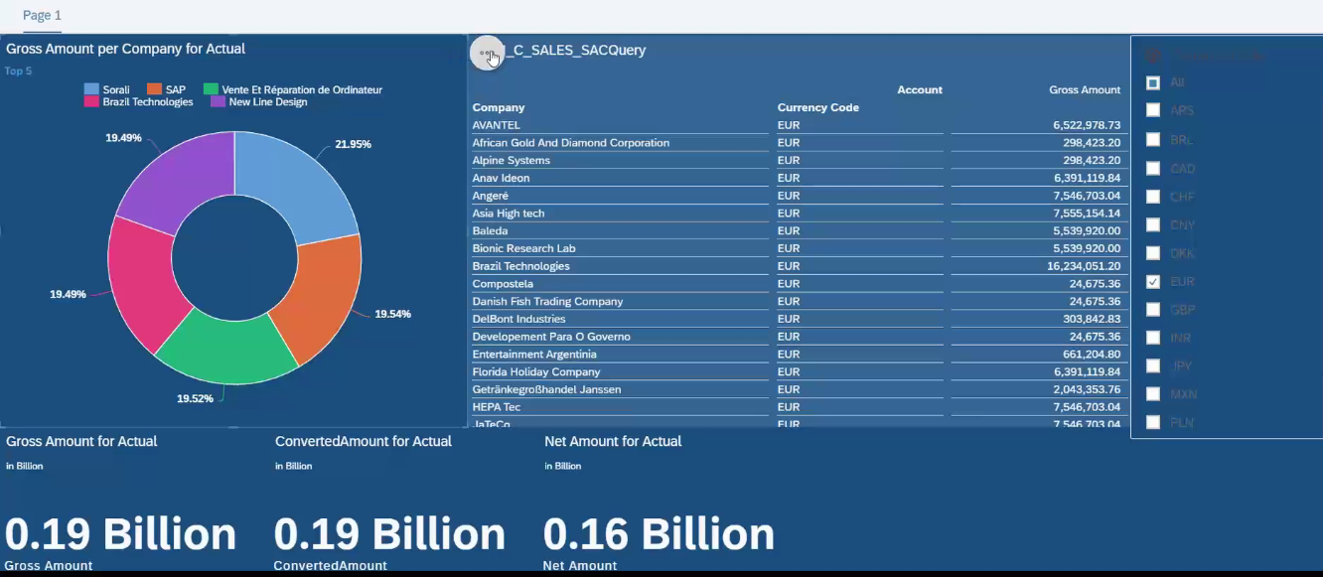
Consume CDS in Analytics Cloud
01
02
03
04
Establish Connection
Create CDS for Analytics
Create Model on top of CDS
Create Dashboard
Notes:
www.anubhavtrainings.com

Slide 13

End of Day 19
Notes:
www.anubhavtrainings.com

Slide 14

Questions
Notes:
www.anubhavtrainings.com

Slide 15

Anubhav Oberoy
Notes:
www.anubhavtrainings.com

Slide 16


We’re committed to empower you to be
Most Desirable Resource
through powerful training solutions.
We build the workforce of the future.
250+
Corporate Clients
30,000+
Learners Trained
25000+
Learners Placed
FREE WEBINARS
Sign up for free webinars with industry experts every fortnight!
Enroll Now!
Contact us today!
https://anubhavtrainings.com/
Notes:
www.anubhavtrainings.com

Slide 17




More from AnubhavTrainings.com
Notes:
www.anubhavtrainings.com

